Slide 1

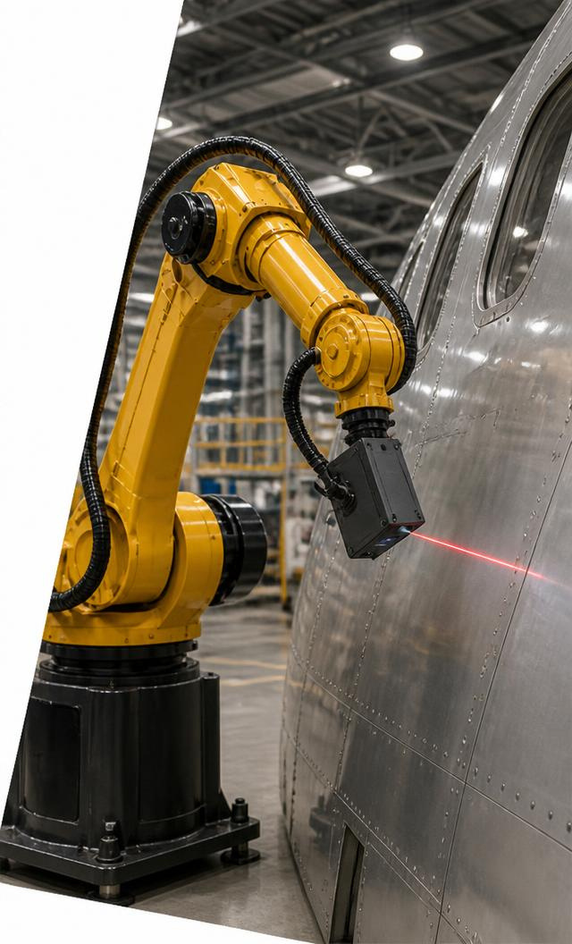
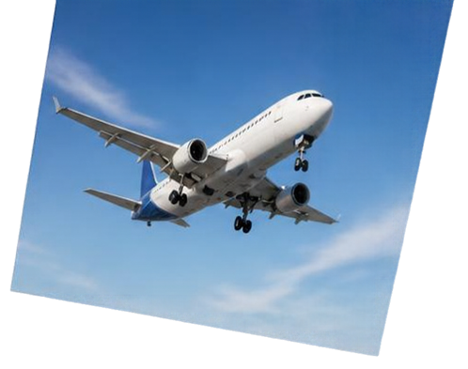
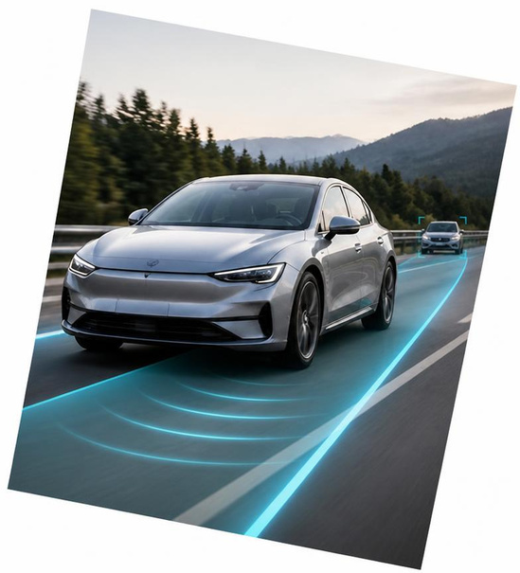
Autonomy in Motion
Rasitha R
Motion Planning & Execution

Slide 2



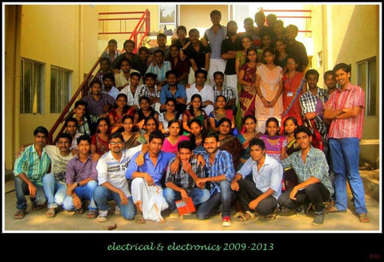
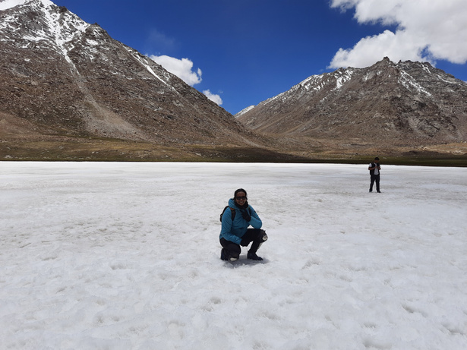
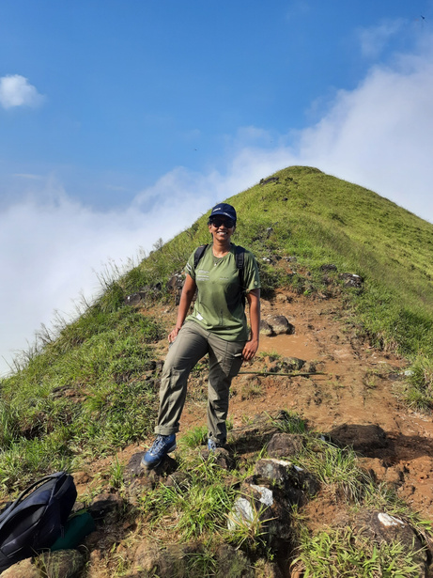
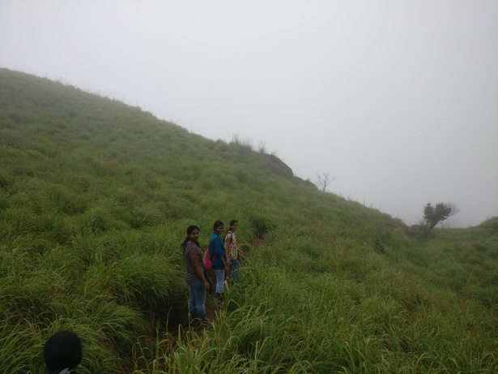

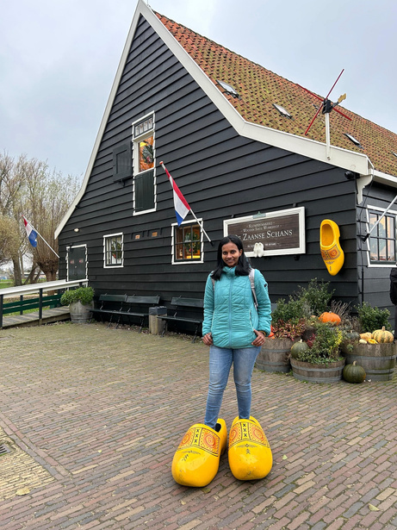
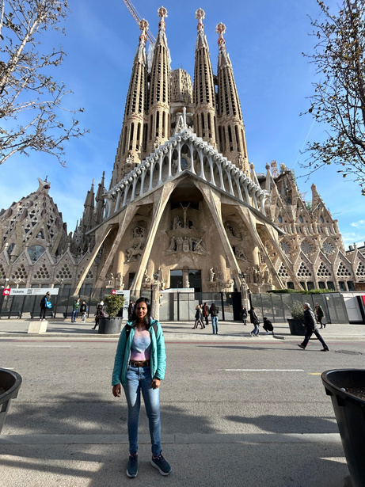
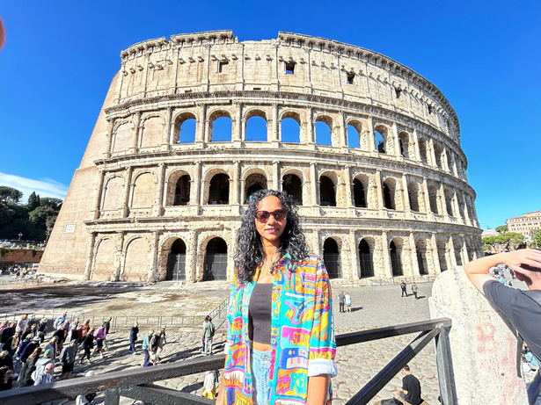
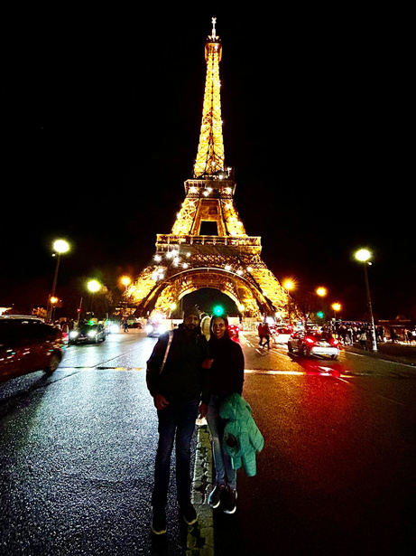
Background & Technical identity
2011 • Bachelor's
Engineering core
Reading
Thinking, Fast and Slow
Daniel Kahneman
Curiosity & empathy
2011–2013
Guest Lecturer
Kerala roots
Classical dance
Grounded in my heritage
Creativity & precision
Teaching & mentoring
2013–2015 • Master's
Advanced engineering
Trekking & fitness
Travel & exploration
Resilience & teamwork
New places • new perspectives
GUIDING PRINCIPLES
Grounded Roots • Precision Creativity • Expedition Resilience • Cognitive Integrity

Slide 3
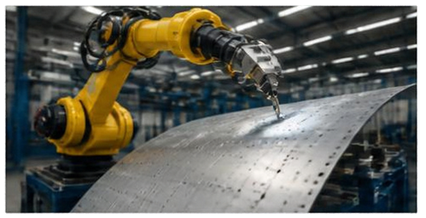
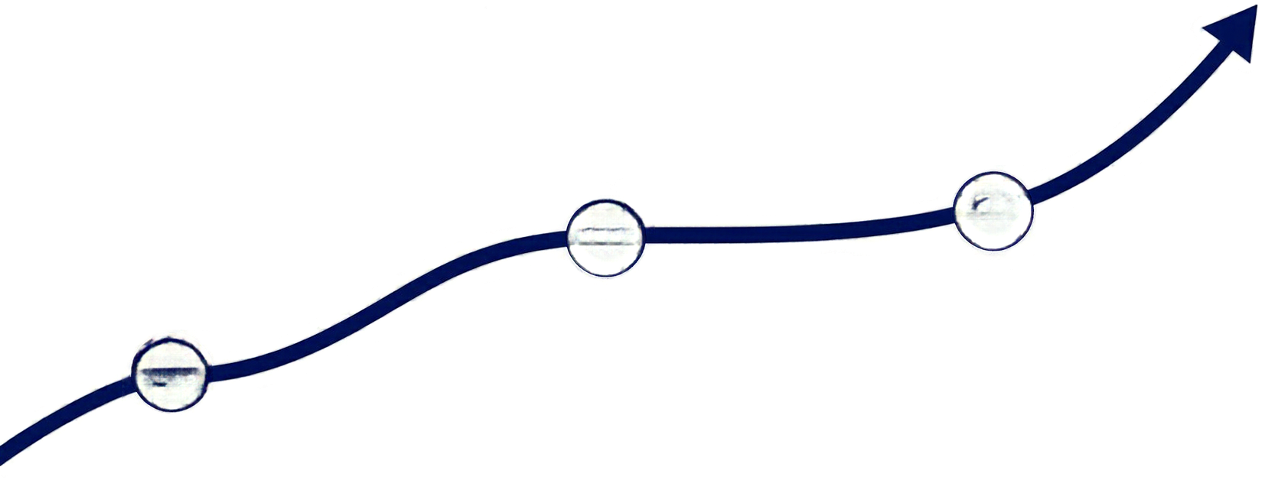
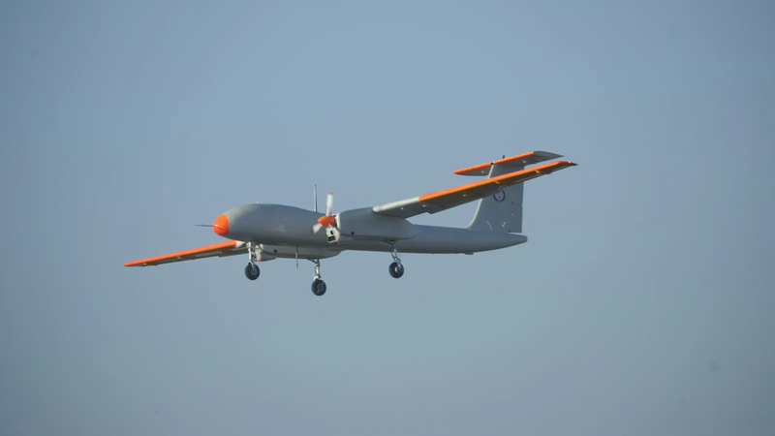
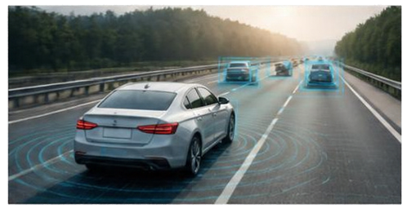


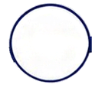
Career trajectory
One passion for autonomy, across flight, vehicles and factories
2015–2016 ADE–DRDO
Flight control
Rustom-2 stabilisation software
03
02
Supported Rustom-2’s
maiden flight
2016–2022 Danlaw
2022–Present Airbus
Driver assistance (ADAS)
Collision warning, cruise control,
platooning & more for automakers
Industrial robotics
Motion planning & execution for
inspection and manufacturing
01
Earlier hazard awareness,
controlled speed &
coordinated following
Less manual programming,
reusable planning &
repeatable motion
Rustom-2 photo: Government of India / DRDO, CC BY-SA 4.0

Slide 4


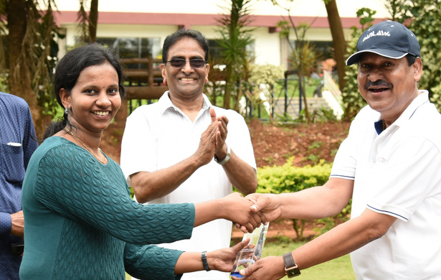



Achievements & recognition
Academic excellence, industry recognition and continued learning
2× Wheel of Excellence
Spot Award
Danlaw • received twice
Airbus
CERTIFICATIONS
Design and Analysis
of Algorithms
Deep Learning
Specialization
Neural Networks
and Deep Learning
Simulink Model Management
and Architecture
NPTEL
Coursera
Coursera
MathWorks
Notes:
Gold Medallist for a master’s in Control Systems at Calicut University. Wheel of Excellence Award at Danlaw, received twice. Spot Award from Airbus. Certifications: Design and Analysis of Algorithms from NPTEL; Deep Learning Specialization and Neural Networks and Deep Learning from Coursera; Simulink Model Management and Architecture from MathWorks. Award illustrations are generic symbolic artwork generated with imagegen; they are not photographs of the actual awards.

Slide 5
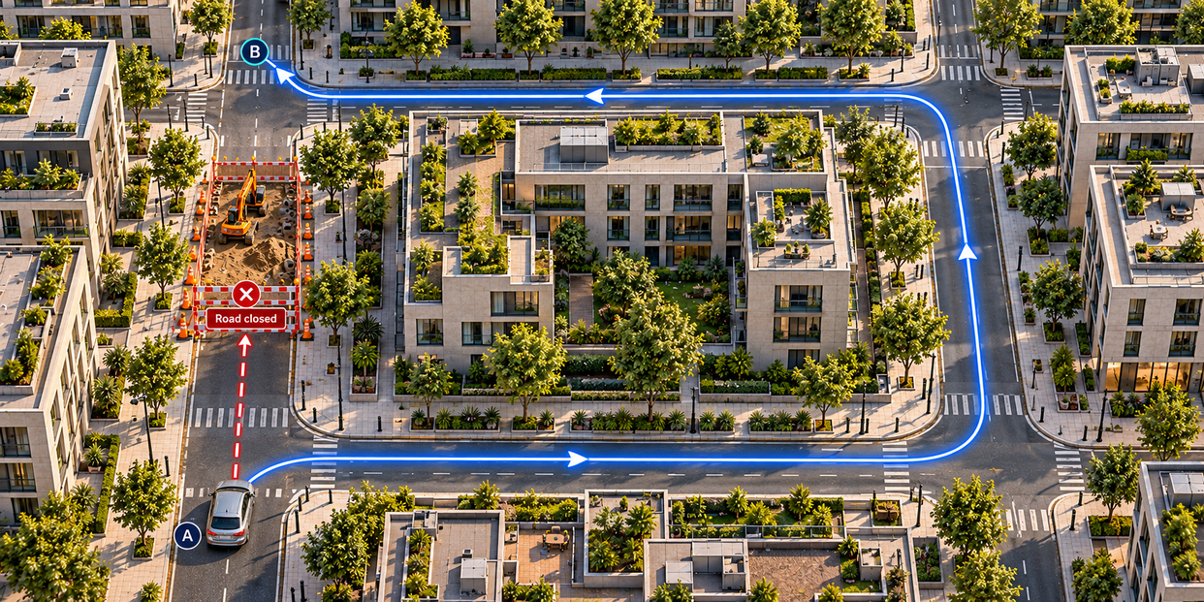
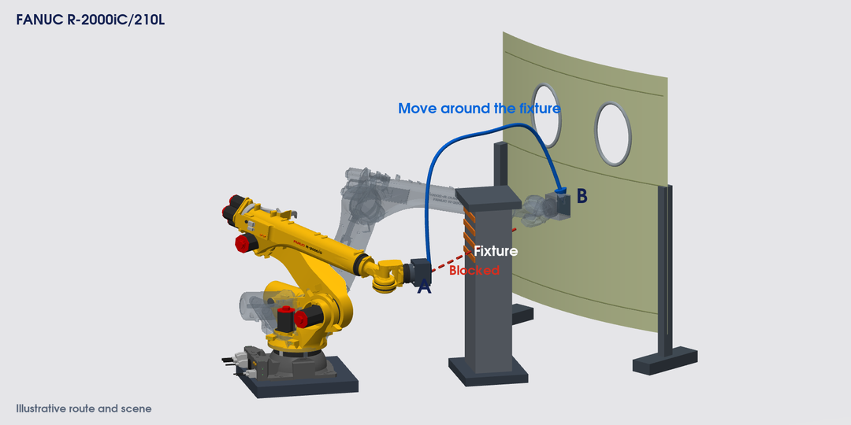
Motion planning
From Google Maps to robot movement
On the road
A: Start point • B: Destination
Obstacle: Roadworks block the direct road.
Plan: Take a detour around the block.
At the aircraft
A: Start position • B: Inspection position
Obstacle: A fixture blocks the direct route.
Plan: Move around it with the whole arm.
Maps guides the driver. Robot planning works out how the whole arm moves.

Slide 6

Motion planning
You choose your way. A robot needs a plan.
In the office
Goal: Reach the empty chair.
In the way: Tables and people.
Choice: Walk around them.
At the aircraft
A: Start position • B: Inspection position
Obstacle: A fixture blocks the direct route.
Plan: Move around it with the whole arm.
Reach the goal. Avoid collisions. Reduce unnecessary movement.

Slide 7

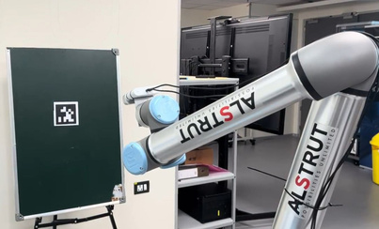
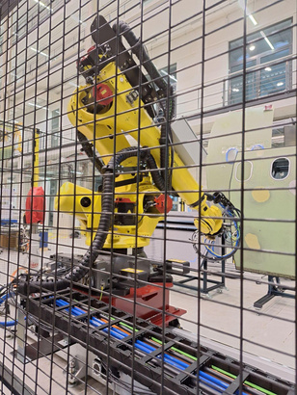
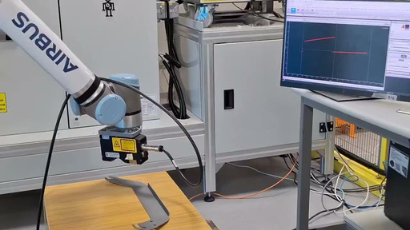
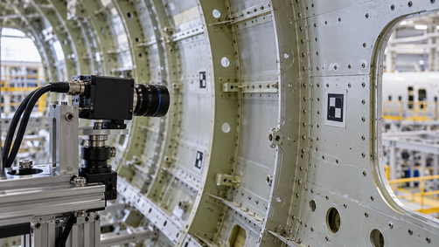
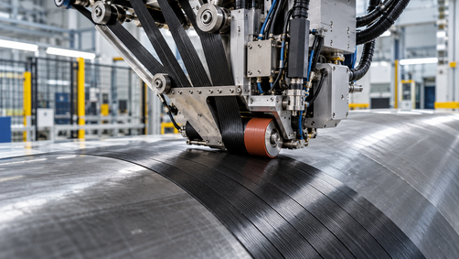
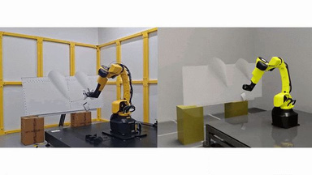
My Airbus milestones
05 / Interlocking photo panels · Bringing autonomy into manufacturing
REACT
Primer Skin NDT
SAMU · Sealant
Led planning + software.
Airbus’ first online planning demo: vision, planning and control.
TRL4 contribution; ZAL Hamburg demo.
Repeatable scans; less programming.
Advanced sensor-guided correction.
Enabling adaptive sealant placement.
iMOd2† · MATS
eAction† · Nextgen layup
Intelligent Scan & Plan
Contributed referencing and alignment.
Matching robot motion to the real part.
Own layup optimisation.
Turning process variation into improvement priorities.
Contributed defect sequencing and rescans at Saint-Nazaire.
Less unnecessary travel.
REACT: led TRL3 demonstration and intermediate TRL4 validation; validated offline/online planner benchmark.
† AI illustrations: iMOd2/MATS and eAction. All other visuals are from your project deck.

Slide 8

My Airbus milestones
06 / Wave journey · Bringing autonomy into manufacturing
Scan & Plan
Aluminium
eAction†
Nextgen layup
iMOd2†
MATS
SAMU
Sealant
Primer Skin
NDT
REACT
Contributed defect sequencing and rescans at Saint-Nazaire.
Less unnecessary travel.
Own layup optimisation.
Turning process variation into improvement priorities.
Contributed referencing and alignment.
Matching robot motion to the real part.
Advanced sensor-guided correction.
Enabling adaptive sealant placement.
TRL4 contribution; ZAL Hamburg demo.
Repeatable scans; less programming.
Led planning + software.
Airbus’ first online planning demo: vision, planning and control.
REACT: led TRL3 demonstration and intermediate TRL4 validation; validated offline/online planner benchmark.
† AI illustrations: iMOd2/MATS and eAction. All other visuals are from your project deck.

Slide 9

My Airbus milestones
08 / Vertical signpost
REACT
Led planning + software.
Airbus’ first online planning demo: vision, planning and control.
Primer Skin NDT
TRL4 contribution; ZAL Hamburg demo.
Repeatable scans; less programming.
Advanced sensor-guided correction.
Enabling adaptive sealant placement.
SAMU
iMOd2 / MATS†
Contributed referencing and alignment.
Matching robot motion to the real part.
Own layup optimisation.
Turning process variation into improvement priorities.
eAction†
Scan & Plan
Contributed defect sequencing and rescans at Saint-Nazaire.
Less unnecessary travel.
REACT: led TRL3 demonstration and intermediate TRL4 validation; validated offline/online planner benchmark.
† AI illustrations: iMOd2/MATS and eAction. All other visuals are from your project deck.

Slide 10

Innovation at Airbus
Two proofs of concept: adaptive motion and Physical AI manipulation
Learning to adapt motion
Manipulation with Physical AI
POC lead • built on 1XRD learnings
Mentor • collaboration with 1XRD
RL agents for dynamic navigation
Physical AI for manufacturing manipulation
Demonstrated: inspection coverage planning
Guided selection and use of task-specific
Vision–Language–Action (VLA) models
Adapting to changing shop-floor obstacles
with less explicit reprogramming
Combining vision and 3D-printable tactile sensors
Applying Physical AI and automated decision-making
where they add value to manufacturing processes.

Slide 11
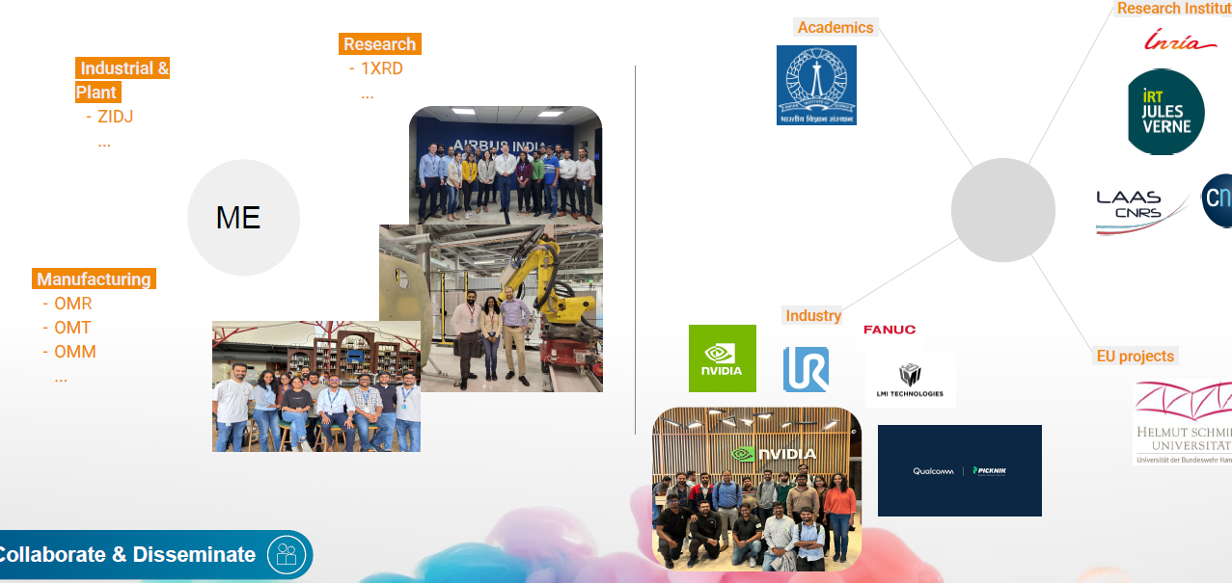

My network & technical influence
Collaboration across Airbus, academia, research and industry
WITHIN AIRBUS
BEYOND AIRBUS
Industrial &
plant
Motion planning & execution
Academia
ZIDJ
Research institutes
Research
1XRD
CNRS
Rasitha
Industry
Manufacturing
OMR, OMT, OMM
EU collaborations
Helmut Schmidt University
COLLABORATE & DISSEMINATE
I connect teams and share results that others can reuse.
Joint development and knowledge sharing
Notes:
Style option for slide 9 of Autonomy in Motion. Rebuilt from the user reference image(20261020-060042).png using native editable text and diagram objects, with its real photos and logos retained using native crop windows. The screenshot is low resolution. Use original photo/logo files for final quality. Airbus siglums are transcribed as ZIDJ, 1XRD, OMR, OMT and OMM. Verify whether the research siglum begins with the numeral 1. CNRS and Helmut Schmidt logos are cut off at the reference edge and therefore appear as plain text. The user reference places Helmut Schmidt University under EU projects; confirm actual project names before finalisation. Categories represent the user-provided network, not invented endorsements. Suggested contribution statement: I connect teams and share results that others can reuse. Circular design requested by the user. Seven lines represent collaboration and knowledge exchange, not measured influence or a reporting hierarchy. Central name uses the user's supplied profile name. Slides 1 to 8 of the approved main deck are unchanged.

Slide 12
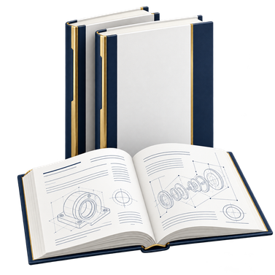

Turning technical ideas into shared knowledge
Make ideas reusable through protected innovation and published knowledge.
Shared knowledge
Technical innovation
WHITE PAPER 1
IDD / DEFENSIVE PUBLICATION
A review of path and motion planning in robotics: core components, evolution, and learning based methods
A novel framework for real-time, hard constrained reinforcement learning in robotics
Team: Shared reference for planner selection
Airbus: Better-informed technology decisions
Team: Reusable basis for constrained learning
Airbus: Supports controlled AI adoption
WHITE PAPER 2
PATENT / ACTIVE
Intelligent programming for industrial robots in aircraft manufacturing: a case study on bridging offline and online paradigms
Self aware motion planning algorithms
Real-time collision / singularity avoidance for autonomous trajectory generation on diverse panel surfaces
Team: Reusable guidance for adaptive programming
Airbus: More flexible aircraft manufacturing
Team: Less manual trajectory correction
Airbus: Adaptable planning across panel shapes
Notes:
WHITE PAPER 1
A review of path and motion planning in robotics: core components, evolution, and learning-based methods
Authors: Rasitha R, Phani Kiran
Proposed team value: Common reference for planner selection and skill development
Proposed Airbus value: Supports consistent robotics technology choices
WHITE PAPER 2
Intelligent programming for industrial robots in aircraft manufacturing: a case study on bridging offline and online paradigms
Authors: Rasitha R, Phani Kiran
Proposed team value: Guidance on offline preparation and online adaptation
Proposed Airbus value: Supports more flexible aircraft manufacturing automation
IDD / DEFENSIVE PUBLICATION
A novel framework for real-time, hard-constrained reinforcement learning in robotics
Proposed team value: Framework for evaluating learning with hard constraints
Proposed Airbus value: Supports assessment of learning-based automation within operating limits
PATENT / ACTIVE
Self-aware motion planning algorithms. Real-time collision / singularity avoidance for autonomous trajectory generation on diverse panel surfaces
Authors: Parameswaran S, Rasitha R, Alexandre Arnold
Proposed team value: Automated collision and singularity avoidance approach
Proposed Airbus value: Targets less manual reprogramming across panel shapes
Titles, authors and statuses supplied by Rasitha R. Display titles are shortened for readability. Value statements are inferred from the supplied titles and scope, rather than verified adoption, measured results or legal conclusions. Active patent status is reproduced as supplied and does not assert a grant or filing stage. Defensive-publication authors were not supplied. All images are symbolic AI-generated illustrations.

Slide 13
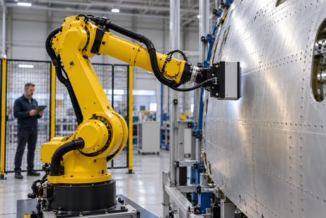
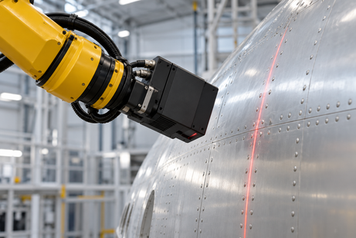
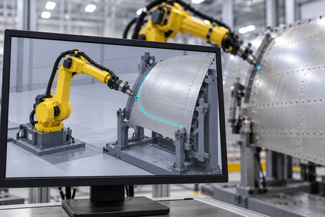
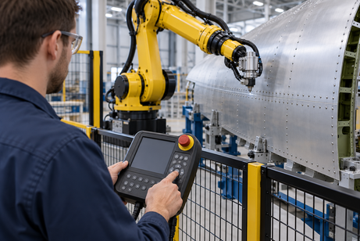
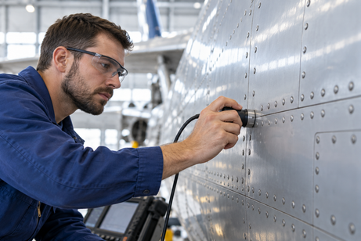
A progressive path to autonomy
From a person guiding each move to a robot handling a defined task
5
Task
autonomy
Adaptive
execution
Robot handles an agreed task
4
Less routine intervention
Robot adjusts to the surface
3
Automatic
planning
Less manual correction
Programmed
automation
2
Software prepares the route
Less programming effort
Robot repeats a taught routine
Manual
control
1
Repeatable known processes
People guide the inspection
Expert process knowledge
Increase autonomy where it adds value. Validate every step.
Notes:
Source: user-supplied reference image(20261020-101400).png for the 3D pyramid shape, and the previously supplied progressive-autonomy slide for content. The five layers distinguish manual control, programmed automation, automatic planning, adaptive execution and task autonomy. NC and offline programming are grouped into programmed automation. These are conceptual capabilities, not a formal autonomy standard. Human expertise, models and offline preparation remain useful. Task autonomy applies to selected tasks within agreed and validated limits. Benefits are intended value, not measured results. Pyramid dimensions are illustrative and do not quantify adoption, scale or intelligence. Suggested narration: Each layer adds a capability. We begin with human expertise and repeatable programs. Planning software reduces preparation effort. Feedback helps the robot adjust. The top is autonomy for selected tasks within validated limits.
Images are AI-generated conceptual illustrations, not photographs of Airbus projects or proof of achieved autonomy. Each scene illustrates the same aircraft-inspection setting. Manual: a person positions a probe. Programmed: a taught repeatable robot routine. Automatic planning: software prepares a route. Adaptive: a wrist-mounted scanner measures the surface to support adjustment. Task autonomy: the robot carries out an agreed inspection task under human supervision. Offline programming and NC remain examples of programmed automation. Intended value is illustrative, not a measured performance claim.
Image prompt set: [{"key":"manual","prompt":"Use case: photorealistic-natural. Asset type: one small landscape photograph-style conceptual illustration for a presentation about progressive manufacturing autonomy, not documentary evidence. Wide 3:2 composition, polished realistic industrial photography, cool neutral hangar, bright soft lighting, physically plausible hardware, uncluttered close framing for legibility at thumbnail size. Curved aluminium aircraft skin panel with rows of rivets. No logos, text, labels, decorative graphics, watermarks or sci-fi holograms. Show a human inspection technician, wearing blue work clothes and safety glasses, manually holding an ultrasonic inspection probe directly against the aircraft skin with their right hand and checking the surface. Hand, probe and surface are central and clear. A realistic human guides the entire operation. No robot."},{"key":"programmed","prompt":"Use case: photorealistic-natural. Asset type: one small landscape photograph-style conceptual illustration for a presentation about progressive manufacturing autonomy, not documentary evidence. Wide 3:2 composition, polished realistic industrial photography, cool neutral hangar, bright soft lighting, physically plausible hardware, uncluttered close framing for legibility at thumbnail size. Curved aluminium aircraft skin panel with rows of rivets. No logos, text, labels, decorative graphics, watermarks or sci-fi holograms. Show a technician using a physical industrial robot teach pendant at the outside of a robot cell. A yellow six-axis industrial arm stands stationary near an aircraft skin panel in the background. Prominent foreground hand pressing the pendant's directional controls communicates a person teaching a repeatable movement. Sensor mounted firmly and coaxially on the robot's final wrist flange; no detached floating tools. Safety barrier between person and robot, no text."},{"key":"planning","prompt":"Use case: photorealistic-natural. Asset type: one small landscape photograph-style conceptual illustration for a presentation about progressive manufacturing autonomy, not documentary evidence. Wide 3:2 composition, polished realistic industrial photography, cool neutral hangar, bright soft lighting, physically plausible hardware, uncluttered close framing for legibility at thumbnail size. Curved aluminium aircraft skin panel with rows of rivets. No logos, text, labels, decorative graphics, watermarks or sci-fi holograms. Show an engineer's monitor in a robotics workcell, angled almost front-on. Monitor clearly depicts a simple 3D simulation of a yellow six-axis robot beside a curved aircraft skin panel, with one cyan planned trajectory curving around a grey fixture to the panel. A yellow real robot and aircraft skin are softly out of focus behind it. The monitor is the central subject, screen has only diagram and no words or numbers. A conceptual route preview, not a specific software product."},{"key":"adaptive","prompt":"Use case: photorealistic-natural. Asset type: one small landscape photograph-style conceptual illustration for a presentation about progressive manufacturing autonomy, not documentary evidence. Wide 3:2 composition, polished realistic industrial photography, cool neutral hangar, bright soft lighting, physically plausible hardware, uncluttered close framing for legibility at thumbnail size. Curved aluminium aircraft skin panel with rows of rivets. No logos,...

Slide 14

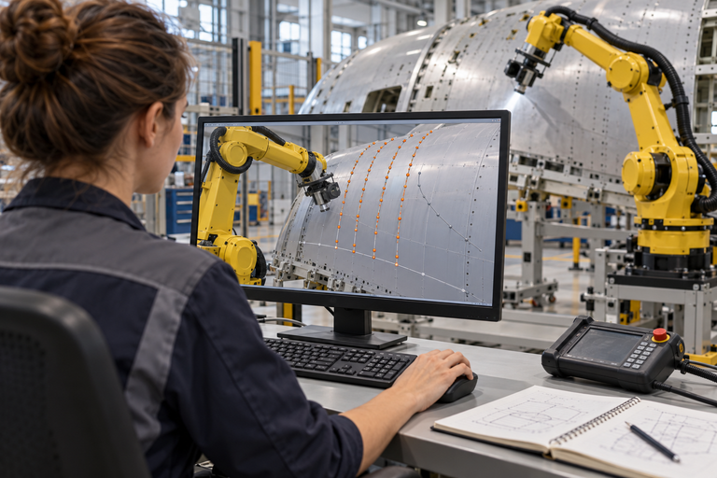

Why autonomous motion matters
A new panel
Back to programming
With autonomous motion
Different shape or position
Adjust paths. Run trials. Repeat.
Plan and adapt to the surface
Repeat for every new panel
WHAT AUTONOMY CHANGES
Automatic motion planning
Adaptive execution
Task autonomy
Less programming
Fewer corrections
Less intervention
Target: lower preparation cost and more engineering capacity
Notes:
Suggested narration (about 50 seconds):
Imagine the next aircraft panel arrives for inspection. The inspection requirement is familiar, but its curvature or its position is different. In a workflow based on taught or offline paths, that change can send an engineer back to the program to adjust the motion and try it again on the cell. This is the repeated effort I want to reduce. Automatic motion planning prepares a route for the new geometry, checking reach and configured constraints. Adaptive execution adjusts that motion using measured changes. Task autonomy then completes the agreed inspection, with people handling exceptions. The return loop represents recurring preparation when a new panel geometry requires different robot motion. The intended value is less preparation and correction effort, more engineering capacity for process quality, and a system that can handle supported panel variants more readily.
Bridge from slide 12: The pyramid showed increasing autonomy. This slide explains why capabilities 3, 4 and 5 matter when a real panel changes.
Bridge to the next two vision slides: First, explain how the motion capability could become a common framework across applications. Then explain how it could work with perception, software and simulation in a common robotics platform towards Physical AI. These vision topics intentionally remain outside this slide.
Value framing: Benefits are expected, not measured Airbus savings. Compare the current and proposed workflows on matched panels and equivalent quality criteria. Measure engineering hours for motion preparation, correction hours, cell trial hours and interventions per completed job. Report net cost savings only after including integration, sensing, compute, commissioning, validation and maintenance costs. Do not assume that less programming means zero setup or zero validation.
Capability boundaries: Automatic planning uses a configured robot, tool, task, geometry and constraints. Adaptive execution requires suitable sensing and control. Task autonomy remains within a defined operating envelope and escalates exceptions. This slide does not claim operation on every panel or surface. Offline programming remains useful for stable, repeatable processes. Constraint checking does not replace physical validation or cell safety engineering.
Technical grounding: https://moveit.picknik.ai/main/doc/concepts/motion_planning.html (motion generation, constraints, collision checking and planning pipeline), reviewed 20 October 2026. These are general capability examples, not a claim that a particular software product is deployed at Airbus.
Visual disclosure: Images are AI-generated conceptual illustrations, not actual Airbus project photographs. They illustrate a new panel arriving, manual motion reprogramming and autonomous inspection. The reprogramming image is illustrative rather than a specific software interface. Built-in image_gen prompts: undefined

Slide 15
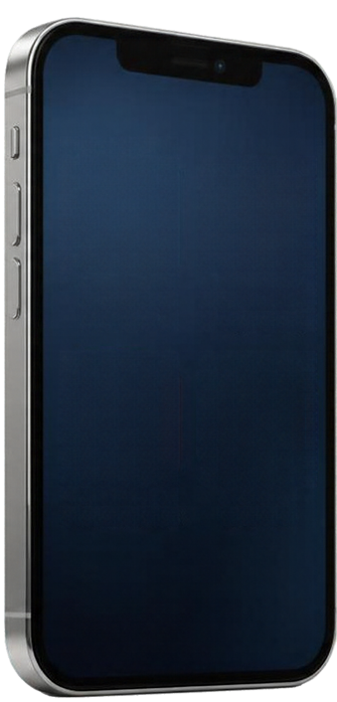


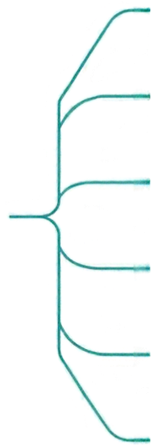
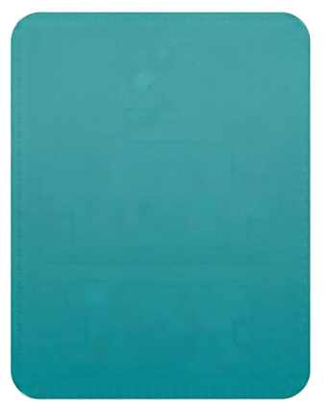






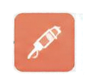




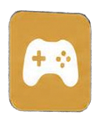





My vision: one foundation, many applications
Shared capabilities. Task-specific choices.
Inspection
Auto Rigging
Common
Motion Planning
Framework
Sealant
Photos
Payments
Pick & Place
Select toolpath,
planner and
constraints per task
Sanding
Video Calls
Games
Polishing
Reuse proven
work
Integrate
faster
Share
improvements

Slide 16

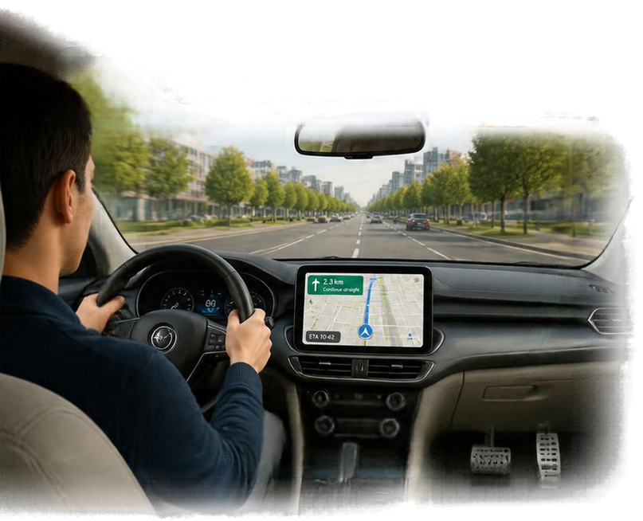
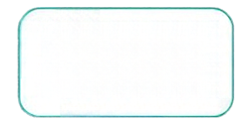
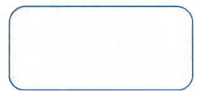
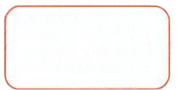


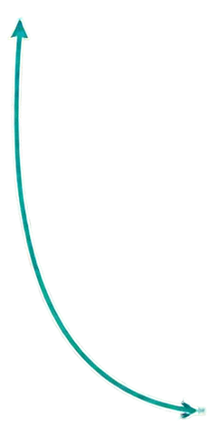
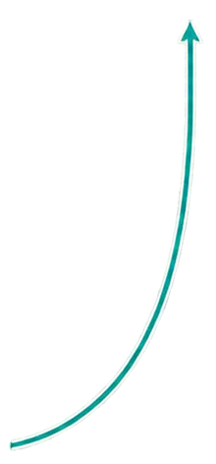
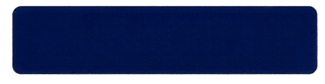

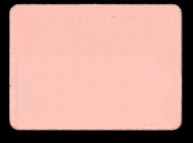



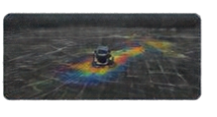
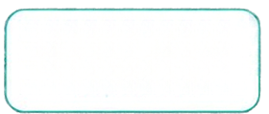




My vision: a complete robotics product
A navigation app alone cannot drive a car
See road
Perception
Navigation
Planning
Steer & brake
Control
See the panel
Vision
Plan the movement
Motion planning
Execute the task
Control
Task orchestrator: coordinates the whole task
Software stack: connects components & shares data
Monitor → coordinate → execute → adjust
Shared core • task-specific configuration
Inspection
Sealant
Simulation
Observe & adjust
Feedback
Design
Test
Deploy
Support &
improve
Together, these capabilities contribute a foundation for Physical AI

Slide 17
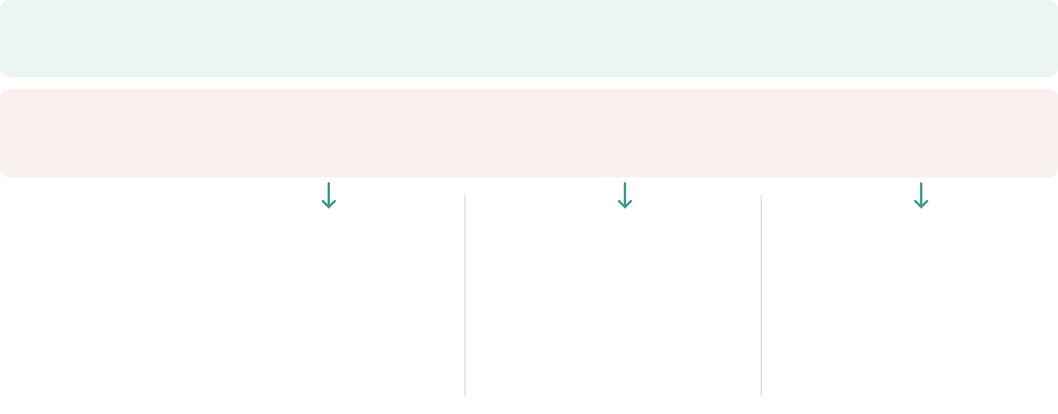
Vision & challenges
From application-specific effort to reusable, adaptive robotics
Business
challenges
New panels,
repeated programming
One-off solutions,
repeated integration
Complex tasks,
manual intervention
Technical
challenges
Different surfaces,
obstacles & motion limits
Reliable integration,
testing & lifecycle support
Limited task data &
reliable AI decisions
The direction
One motion foundation
Task-specific choices
One robotics platform
Reuse across its lifecycle
Physical AI where useful
Adaptive task decisions
Less preparation effort • reusable engineering • more adaptable manufacturing

